Slide 1
CSE 220
Jannatun Noor
Lecture made by: Aminul Huq

Slide 2
Types of Algorithms
In generally based on how you solve a problem algorithms are classified in two types
Iterative Algorithms
Recursive Algorithms

Slide 3
Iterative Algorithms
Iterative algorithms are the ones with which we solve are problems traditionally.
Example : Finding the maximum of two/three/n numbers, calculating the sum of n numbers, selection sorting, bubble sorting.
All of these are iterative process.

Slide 4
Recursive Algorithms
A recursive algorithm is one that solves a problem by solving one or more smaller instances of the same problem.
we use recursive methods—a recursive method is one that calls itself.

Slide 5
Recursive Methods Must Eventually Terminate
A base case does not execute a recursive call
stops the recursion
Each successive call to itself must be a "smaller version of itself”
an argument that describes a smaller problem
a base case is eventually reached

Slide 6
Terminologies
What is a smaller identical problem(s)?
Decomposition
How are the answers to smaller problems combined to form the answer to the larger problem?
Composition
Which is the smallest problem that can be solved easily (without further decomposition)?
Base/stopping case

Slide 7
Advantage of Recursion
1. Reduce unnecessary calling of function.
2. Through Recursion one can Solve problems in easy way while its iterative solution is very big and complex.
For example to reduce the code size for Tower of Hanoi application, a recursive function is bet suited.

Slide 8
Disadvantage of Recursion
1. Recursive solutions may involve extensive overhead because they use function calls.
Each function call requires push of return memory address, parameters, returned result, etc. and every function return requires that many pops.
2. Each time you call a function you use up some of your memory allocation may be in stack or heap. If there are large number of recursive calls – then you may run out of memory.

Slide 9
Factorial Examples
The factorial for any positive integer N, written N!, is defined to be the product of all integers between 1 and N inclusive
public static int factorial(int n) {
int product = 1;
for (int i = 1; i <= n; i++)
product *= i;
return product;
}

Slide 10
Factorial Examples
factorial can also be defined recursively:
A factorial is defined in terms of another factorial until the basic case of 0! is reached
public static int factorial(int n) {
if (n == 0)
return 1;
else
return n * factorial(n - 1);
}

Slide 11
Recursive power example
Write method pow that takes integers x and y as parameters and returns x^{y}. x^{y} = x * x * x * ... * x (y times, in total)
An iterative solution:
public static int pow(int x, int y) {
int product = 1;
for (int i = 0; i < y; i++)
product = product * x;
return product;
}

Slide 12
Recursive power function
Another way to define the power function: pow(x, 0) = 1 pow(x, y) = x * pow(x, y-1), y > 0
public static int pow(int x, int y) {
if (y == 0)
return 1;
else
return x * pow(x, y - 1);
}

Slide 13
How recursion works
each call sets up a new instance of all the parameters and the local variables
as always, when the method completes, control returns to the method that invoked it (which might be another invocation of the same method)
pow(4, 3) = 4 * pow(4, 2)
= 4 * 4 * pow(4, 1)
= 4 * 4 * 4 * pow(4, 0)
= 4 * 4 * 4 * 1
= 64

Slide 14
Infinite recursion
a definition with a missing or badly written base case causes infinite recursion, similar to an infinite loop
avoided by making sure that the recursive call gets closer to the solution (moving toward the base case)
public static int pow(int x, int y) {
return x * pow(x, y - 1); // Oops! Forgot base case
}
pow(4, 3) = 4 * pow(4, 2)
= 4 * 4 * pow(4, 1)
= 4 * 4 * 4 * pow(4, 0)
= 4 * 4 * 4 * 4 * pow(4, -1)
= 4 * 4 * 4 * 4 * 4 * pow(4, -2)
= ... crashes: Stack Overflow Error!

Slide 15
Tracing recursive methods
Consider the following method:
public static int mystery1(int x, int y) {
if (x < y)
return x;
else
return mystery1(x - y, y);
}
For each call below, indicate what value is returned:
mystery1(6, 13) ____________
mystery1(14, 10) ____________
mystery1(37, 10) ____________
mystery1(8, 2) ____________
mystery1(50, 7) ____________

Slide 16
Tracing recursive methods
public static void mystery2(int n) {
if (n <= 1)
System.out.print(n);
else {
mystery2(n/2);
System.out.print(", " + n);
}
}
For each call below, indicate what output is printed:
mystery2(1) ____________
mystery2(2) ____________
mystery2(3) ____________
mystery2(4) ____________
mystery2(16) ____________
mystery2(30) ____________
mystery2(100) ____________

Slide 17
Tracing recursive methods
public static int mystery3(int n) {
if (n < 0)
return -mystery3(-n);
else if (n < 10)
return n;
else
return mystery3(n/10 + n % 10);
}
For each call below, indicate what value is returned:
mystery3(6) ____________
mystery3(17) ____________
mystery3(259) ____________
mystery3(977) ____________
mystery3(-479) ____________
6
8
7
5
-2

Slide 18
Tracing recursive methods
public static void mystery4(String s) {
if (s.length() > 0) {
System.out.print(s.charAt(0));
if (s.length() % 2 == 0)
mystery4(s.substring(0, s.length() - 1));
else
mystery4(s.substring(1, s.length()));
System.out.print(s.charAt(s.length() - 1));
}
}
For each call below, indicate what output is printed:
mystery4("") ____________
mystery4("a") ____________
mystery4("ab") ____________
mystery4("bc") ____________
mystery4("abcd") ____________
aa
aaab
bbbc
aabbbccd

Slide 19
Write a recursive program which sums the first ten positive numbers.

Slide 20
THE EUCLIDEAN ALGORITHM
The Euclidean Algorithm computes the greatest common divisor of two positive integers.
It says to subtract repeatedly the smaller number n from the larger number m until the resulting difference d is smaller than n. Then repeat the same steps with d in place of n and with n in place of m. Continue until the two numbers are equal.
to find the greatest common divisor of 494 and 130 to be 26. This is correct because 494 = 26􀂘19 and 130 = 26􀂘5.

Slide 21
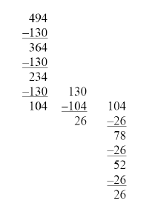
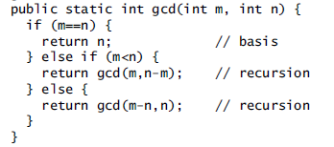

Slide 22
the call gcd(494,130) makes the recursive call gcd(364,130), which makes the recursive call gcd(234,130), which makes the recursive call gcd(104,130), which makes the recursive call gcd(104,26), which makes the recursive call gcd(78,26), which makes the recursive call gcd(52,26), which makes the recursive call gcd(26,26), which returns 26. The value 26 is then successively returned all the way back up the chain to the original call gcd(494,130), which returns it to its caller.

Slide 23
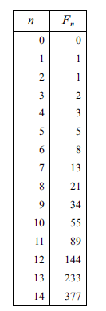

Fibonacci Numbers

Slide 24
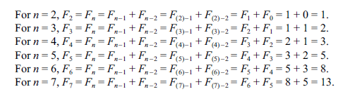

Slide 25
